Slide 1
Guide to Data and Information Sharing Workflows Across the Life Cycle of Transportation Assets
June, 2016

Slide 2
Outline
Information delivery manual (IDM)
An example of IDM
Plan to develop IDM for transportation assets

Slide 3
Data sharing guidance in the vertical sector
Information Delivery Manual (IDM)

Slide 4
Business use case
A scenario within the life cycle of project in which data exchange is required to enable the completion of a product of the project.
Examples:
The data exchange between architects, structural engineers and HVAC engineers to develop an as-designed model
The data exchange between engineers and cost estimators to support quantity take-off and cost estimation
The sharing of the design models to the energy analysis process
3 elements of a use case
Tasks to be completed
Actors/stakeholders
Data exchange requirements

Slide 5
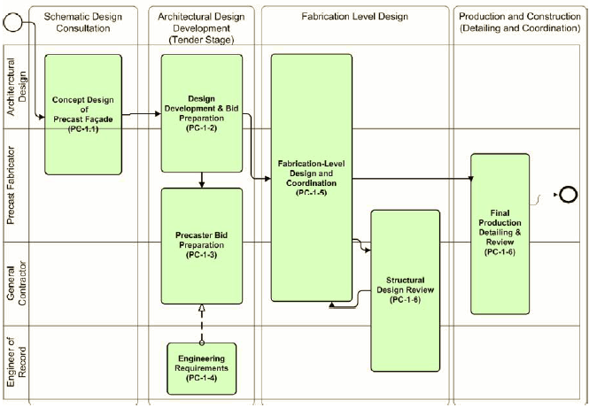
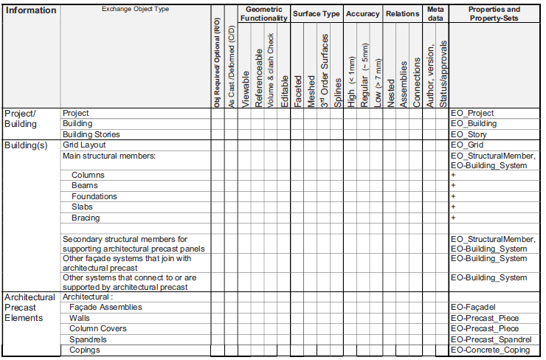
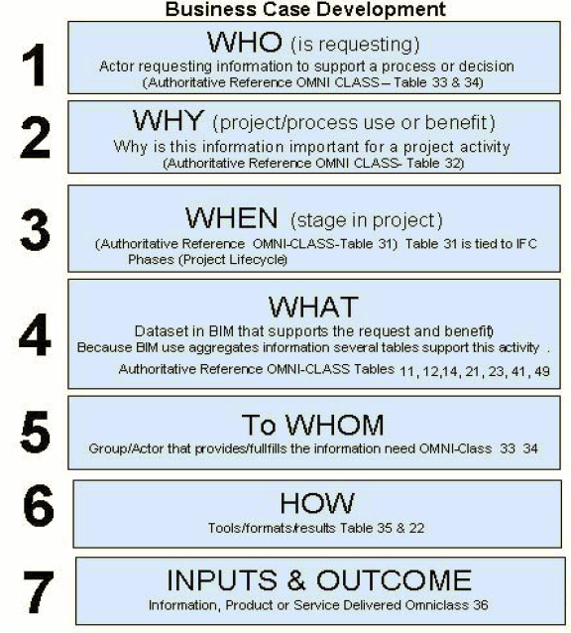
IDM
Process map
Exchange requirement (ER)
IDM aims to answer
processes in which data sharing is required
data producers and receivers
specific data attributes required for a data sharing scenario

Slide 6
IDM
Aim to capture the industry knowledge and experience about the workflow and information sharing flow of a business use case.
Goals:
Identify and describe the processes in which data sharing is required
Identify the data requester and receiver for each data sharing scenario
Document the specific data requirements for a data sharing scenario
2 core components
A process map which explains the sequence of activities to be completed and the actors (stakeholders) involved
Exchange requirements (ER) which specify what data entities/attributes to be transferred to whom and by whom

Slide 7
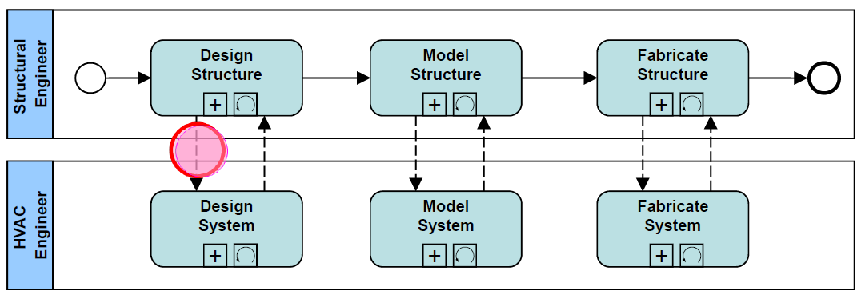
Process Map
A process map describes:
Tasks (activities) to be performed.
Sequencing of tasks.
Actors (people/organizations) involved.

Slide 8
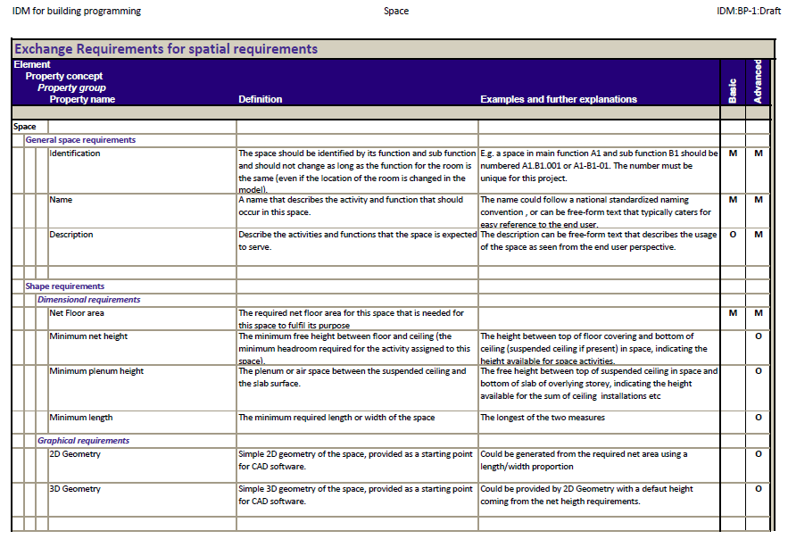
Exchange Requirement (ER)
ER defines what data/information to be shared.
Audience is the user (architect, engineer, constructor, etc.)

Slide 9
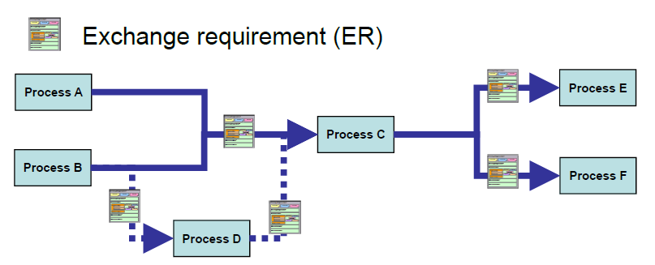
IDM-ER in Process Map
This is an integrated map of process and exchange requirements,
This map shows what data to be shared to whom and when.

Slide 10
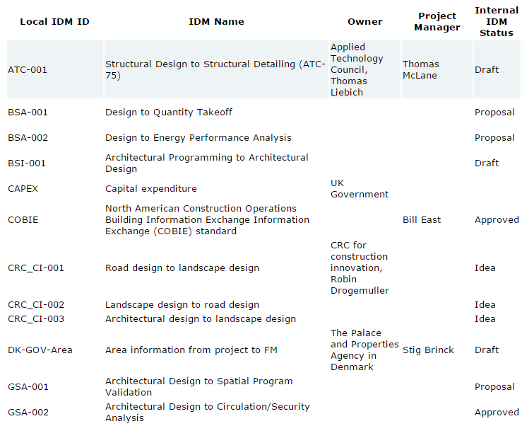
Overview of IDM Projects
04 Approved
01 Under review
12 Draft
18 Work in progress
06 Proposal

Slide 11
IDM for precast concrete

Slide 12
Scope
This IDM focuses on the data exchanges between architects, engineers, general contractors and precast fabricators from the beginning of the programming phase to the end of the fabrication phase.

Slide 13
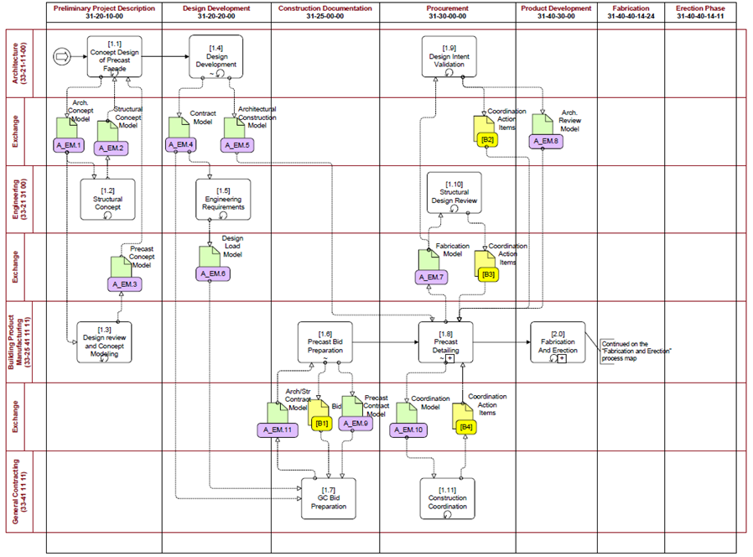
Process map
phase
tasks
actors
exchange requirement

Slide 14
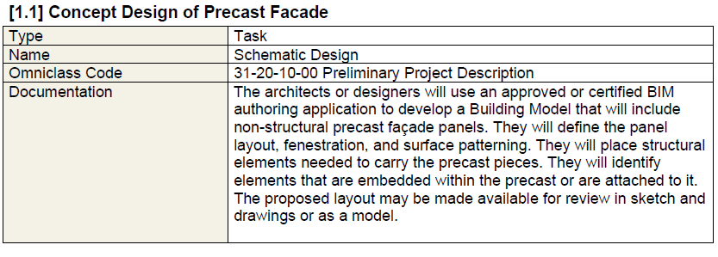
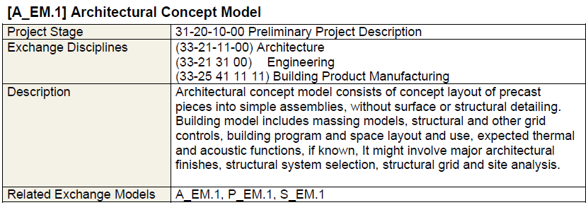
Written descriptions of Process map
Task description
ER description

Slide 15
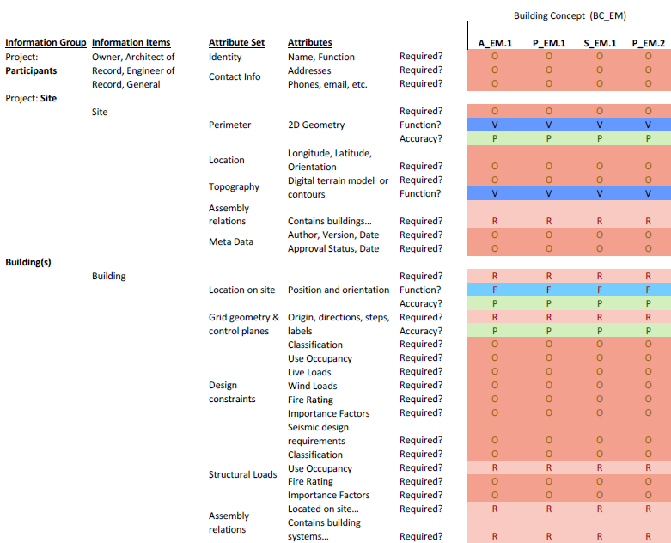
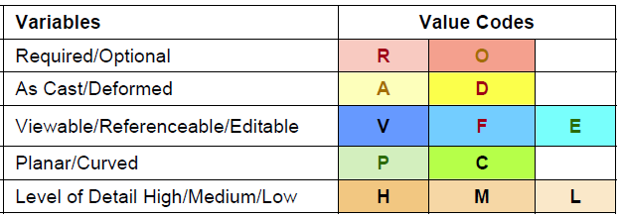
Detailed specification of ER
Data Attributes
ERs

Slide 16
IDM for transportation assets
DEVELOPMENT PLAN

Slide 17
Assets to be investigated
Sign
Culvert
Guard rail
Pavement
Bridge
Others?

Slide 18
Business use case to be investigated
Owner and architects?
Architects and engineers?
Architects and engineers and contractors?
Contractors and asset managers?
Engineers and cost estimator?
Other?
The top prioritized use cases will be developed first!

Slide 19
Workgroup members
Research team
Industry professionals
Selected based the business use case
Potential experts: architects, designers, contracts, asset managers, software vendors

Slide 20
IDM development cycle
Meeting 1
IDM development
Meeting 2
Workgroup discussion
Output: data exchange narratives
By ISU team
ISU team and research panel
Output: detailed IDM
Individual discussions with workgroup members (if necessary)
Present findings
Output: approved IDM

Slide 21
Meeting 1
Workgroup members will discuss:
Workflow which specifies what tasks to be completed and actors involved
Locations in the workflow where data sharing occur
Output: high level workflow and data sharing narratives

Slide 22
IDM development
Input: narratives from meeting 1
ISU team examines the input and develop a detailed and formal process map and ER matrix
Further inputs can be retrieved from individual meetings between ISU team and the workgroup members
Output: a detailed IDM

Slide 23
Meeting 2
The findings will be presented to the research panel
Output: an approved IDM

Slide 24
Discussions
Implementation plan?
Mapping between identified exchange concepts and data entities attributes in software applications?

